Slide 1
.NET/C# Training
Parthiban
14/11/2023
Notes:
This template can be used as a starter file for presenting training materials in a group setting.
Sections
Right-click on a slide to add sections. Sections can help to organize your slides or facilitate collaboration between multiple authors.
Notes
Use the Notes section for delivery notes or to provide additional details for the audience. View these notes in Presentation View during your presentation.
Keep in mind the font size (important for accessibility, visibility, videotaping, and online production)
Coordinated colors
Pay particular attention to the graphs, charts, and text boxes.
Consider that attendees will print in black and white or grayscale. Run a test print to make sure your colors work when printed in pure black and white and grayscale.
Graphics, tables, and graphs
Keep it simple: If possible, use consistent, non-distracting styles and colors.
Label all graphs and tables.

Slide 2
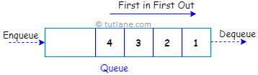
Queue
In c#, Queue is useful for representing a collection of objects that stores elements in FIFO (First In, First Out) style, i.e., the element that added first will come out first. In a queue, elements are inserted from one end and removed from another end.
Queue que = new Queue();
Notes:
Give a brief overview of the presentation. Describe the major focus of the presentation and why it is important.
Introduce each of the major topics.
To provide a road map for the audience, you can repeat this Overview slide throughout the presentation, highlighting the particular topic you will discuss next.

Slide 3
C# Queue Properties
Property | Description
Count | It will return the total number of elements in the queue
IsSynchronized | It is used to get a value to indicate whether access to the queue is synchronized (thread-safe) or not.
Notes:
Give a brief overview of the presentation. Describe the major focus of the presentation and why it is important.
Introduce each of the major topics.
To provide a road map for the audience, you can repeat this Overview slide throughout the presentation, highlighting the particular topic you will discuss next.

Slide 4
Method | Description
Enqueue | It is used to add elements at the end of the queue.
Dequeue | It will remove and returns an item from the start of a queue.
Clear | It will remove all the elements from the queue.
Clone | It will create a shallow copy of the queue.
Contains | It is used to determine whether an element exists in a queue or not.
Peek | It is used to get the first element from the queue.
TrimToSize | It is used to set the capacity of a queue to an actual number of elements in the queue.
Notes:
Give a brief overview of the presentation. Describe the major focus of the presentation and why it is important.
Introduce each of the major topics.
To provide a road map for the audience, you can repeat this Overview slide throughout the presentation, highlighting the particular topic you will discuss next.

Slide 5
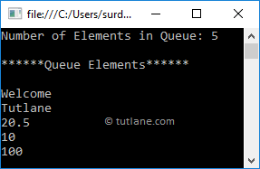
Queue que = new Queue();
que.Enqueue("Welcome");
que.Enqueue("Tutlane");
que.Enqueue(20.5f);
que.Enqueue(10);
que.Enqueue(100);
Console.WriteLine("******Queue Example******");
Console.WriteLine("Number of Elements in Queue: {0}", que.Count);
Console.WriteLine("******Queue Elements******");
// Access Queue Elements
foreach (var item in que)
{
Console.WriteLine(item);
}
Notes:
Give a brief overview of the presentation. Describe the major focus of the presentation and why it is important.
Introduce each of the major topics.
To provide a road map for the audience, you can repeat this Overview slide throughout the presentation, highlighting the particular topic you will discuss next.

Slide 6
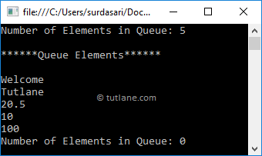
Queue que = new Queue();
que.Enqueue("Welcome");
que.Enqueue("Tutlane");
que.Enqueue(20.5f);
que.Enqueue(10);
que.Enqueue(100);
Console.WriteLine("Number of Elements in Queue: {0}", que.Count);
Console.WriteLine("******Queue Elements******");
// Access Queue Elements
while (que.Count > 0)
{
Console.WriteLine(que.Dequeue());
}
Console.WriteLine("Number of Elements in Queue: {0}", que.Count);
Notes:
Give a brief overview of the presentation. Describe the major focus of the presentation and why it is important.
Introduce each of the major topics.
To provide a road map for the audience, you can repeat this Overview slide throughout the presentation, highlighting the particular topic you will discuss next.

Slide 7
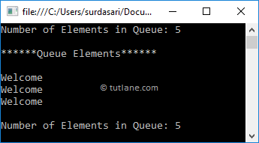
Queue que = new Queue();
que.Enqueue("Welcome");
que.Enqueue("Tutlane");
que.Enqueue(20.5f);
que.Enqueue(10);
Console.WriteLine("Number of Elements in Queue: {0}", que.Count);
Console.WriteLine("******Queue Elements******");
// Access Queue Elements
Console.WriteLine(que.Peek());
Console.WriteLine(que.Peek());
Console.WriteLine(que.Peek());
Console.WriteLine("Number of Elements in Queue: {0}", que.Count);
Console.ReadLine();
Notes:
Give a brief overview of the presentation. Describe the major focus of the presentation and why it is important.
Introduce each of the major topics.
To provide a road map for the audience, you can repeat this Overview slide throughout the presentation, highlighting the particular topic you will discuss next.

Slide 8
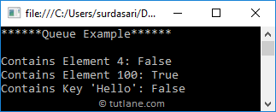
Queue que = new Queue();
que.Enqueue("Welcome");
que.Enqueue("Tutlane");
que.Enqueue(20.5f);
que.Enqueue(10);
que.Enqueue(100);
Console.WriteLine("******Queue Example******");
Console.WriteLine("Contains Element 4: {0}", que.Contains(4));
Console.WriteLine("Contains Element 100: {0}", que.Contains(100));
Console.WriteLine("Contains Key 'Hello': {0}", que.Contains("Hello"));
Notes:
Give a brief overview of the presentation. Describe the major focus of the presentation and why it is important.
Introduce each of the major topics.
To provide a road map for the audience, you can repeat this Overview slide throughout the presentation, highlighting the particular topic you will discuss next.

